Slide 1

Hotel Survey Analysis
Presented by
Gresha Shah

Slide 2
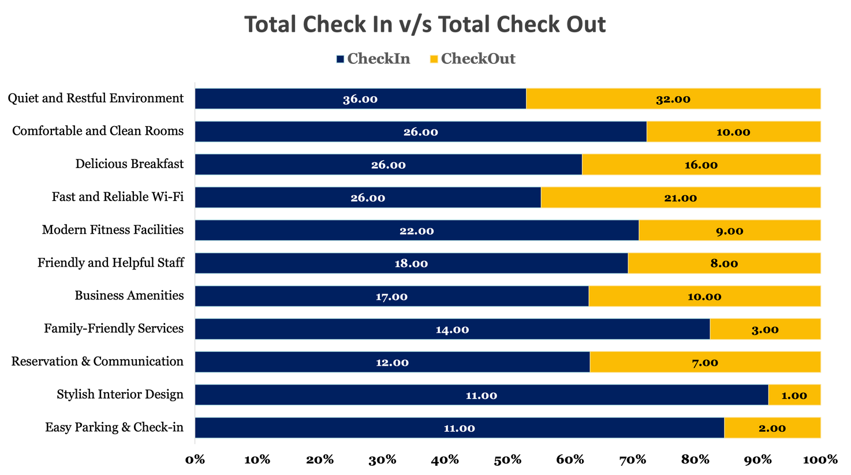
What Drives Guest Decisions — Are We Marketing the Right Features?
Top 3 Factors at Check-In:
Quiet & Restful Environment – 36 mentions
Comfortable & Clean Rooms – 26 mentions
Delicious Breakfast / Fast & Reliable Wi-Fi – 26 mentions each
Low Impact Features:
Stylish Interior Design and Easy Parking & Check-In each received only 11 mentions, suggesting underutilized in promotions, not influencing booking.
At Check-Out:
Quietness and Wi-Fi remain top; Breakfast drops (−38% drop-off).
Style, Parking, and Family Services receive very low praise, signaling either irrelevance or underperformance.
Marketing Opportunity:
Marketing campaigns are effectively aligned with core guest priorities like peace, comfort, and connectivity — but are missing opportunities to showcase style or ease of arrival.

Slide 3
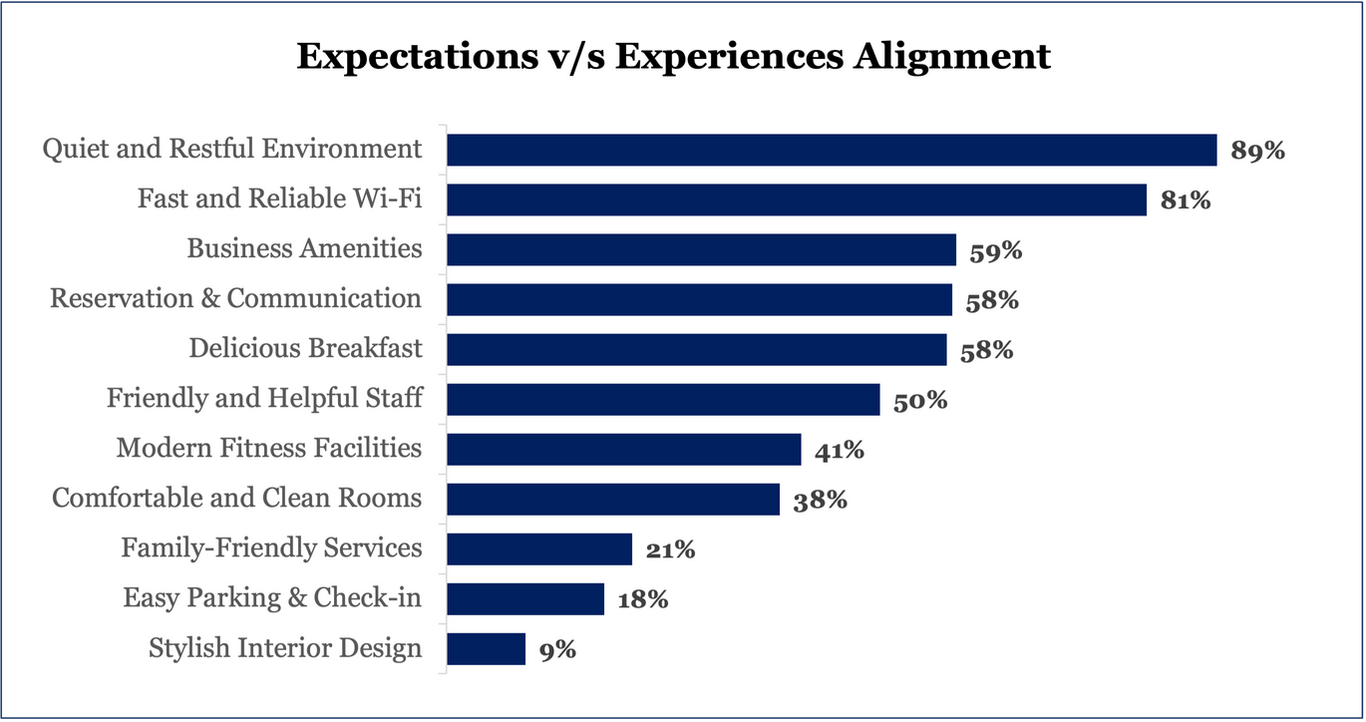
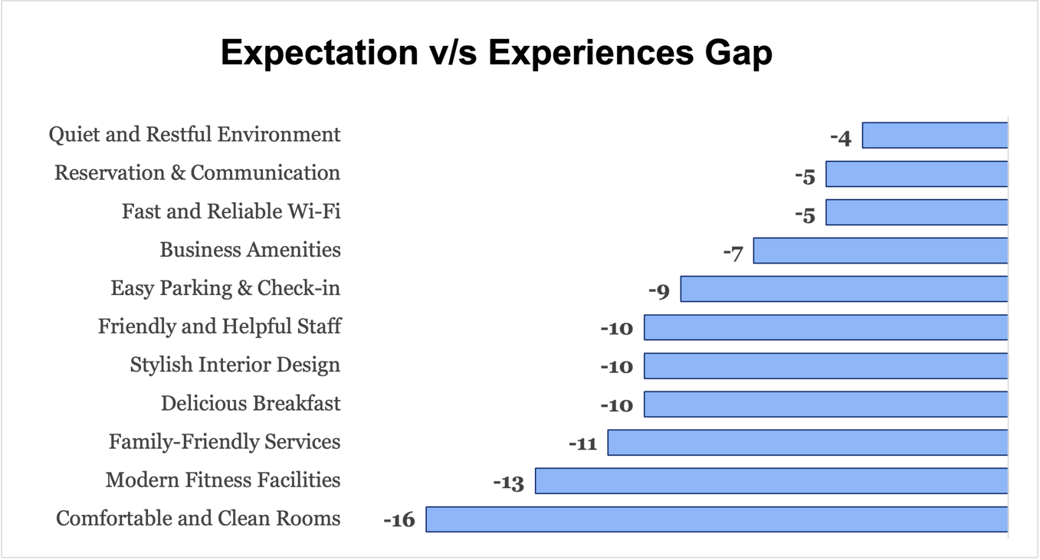
Expectation vs Experience — What's Working vs What’s Not
Strong Alignment (High Expectation & Experience):
Quiet & Restful Environment (89% aligned)
Fast & Reliable Wi-Fi (81% aligned)
Operational strength: What’s being marketed is being delivered.
Gaps Between Expectation & Delivery:
Comfortable & Clean Rooms – High interest but −16 gap in delivery.
Modern Fitness Facilities – −13 gap, indicating dissatisfaction post-arrival.
Interpretation:
While attracting guests with the right messaging, a few high-expectation amenities are falling short on core booking features that fail to deliver, posing a brand reputation risk and risking negative reviews or churn.

Slide 4
Recommendations — Turning Insights into Action
High Impact Aligned (Fast and Reliable Wi-Fi, Quiet and Restful Environment)
Marketing Recommendations:
Feature Wi-Fi speed and the quiet environment prominently in all marketing materials as signature strengths
Create targeted campaigns highlighting "peace and connectivity" as unique selling propositions
Operations Recommendations:
Maintain sound insulation and noise reduction protocols
Plan for regular technology upgrades to maintain Wi-Fi advantage
Low Engagement (Easy Parking & Check-in, Family-Friendly Services, Reservation & Communication, Stylish Interior Design)
Marketing Recommendations:
Present these as complementary amenities rather than key differentiators
Consider bundling these with high-impact features in promotional materials
Operations Recommendations:
Consider simplifying or streamlining these offerings
Implement minimal viable improvements where significant gaps exist (parking, family services)
Needs Improvement (Business Amenities, Friendly and Helpful Staff, Modern Fitness Facilities)
Marketing Recommendations:
Present realistic depictions of these amenities to manage expectations
Target marketing of these features to segments that value them most
Operations Recommendations:
Prioritize staff training to improve service consistency
Conduct focused research to identify specific pain points within each category
Underperforming Priority (Comfortable and Clean Rooms, Delicious Breakfast)
Marketing Recommendations:
Immediately adjust messaging to reflect reality (especially for rooms)
Temporarily reduce imagery and claims about these features until improvements are made
Operations Recommendations:
Implement urgent action plan for room cleanliness and comfort issues
Revamp breakfast offerings based on specific guest feedback

Slide 5
Would love to know your feedback or any questions you may have!
Thank you

